Slide 1

NewsBot Intelligent System
Automated Text Categorization & Analysis using Random Forest Classification
Machine Learning Pipeline for News Intelligence

Slide 2
Project Architecture
A Comprehensive Overview of the NLP Pipeline

Slide 3

Problem Statement
Manual Bottleneck
Intelligent Solution
Categorizing thousands of daily news articles manually is time-consuming and prone to human error, leading to delays in news delivery and poor user experience.
The NewsBot system leverages traditional ML to automatically classify articles into Business, Tech, Politics, Sport, and Entertainment with high precision.

Slide 4

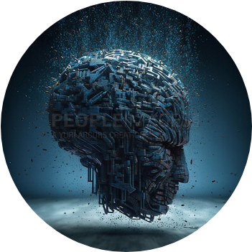
Data Sourcing
BBC News Dataset
The system utilizes the gold-standard BBC News dataset, comprising 2,225 articles from 2004-2005. It covers five distinct topical areas, providing a rich ground for training supervised classification models.
Integration via Kaggle API ensures a seamless, reproducible data ingestion process.

Slide 5
Text Preprocessing
•
NLTK Integration: Robust processing of natural language using the Natural Language Toolkit.
•
Normalization: Case folding and removal of special characters, emojis, and noise.
•
Tokenization & Filtering: Removing stop-words and low-frequency terms (count < 3) to reduce dimensionality.
•
Lemmatization: Converting words to their base forms to ensure semantic uniformity.

Slide 6






Feature Engineering
TF-IDF
N-Grams
Sparse Matrix
Term Frequency-Inverse Document Frequency weighting highlights unique keywords.
Utilizing Bigrams and Trigrams to capture contextual phrases like "stock market."
Optimized data storage for high-dimensional feature vectors.

Slide 7

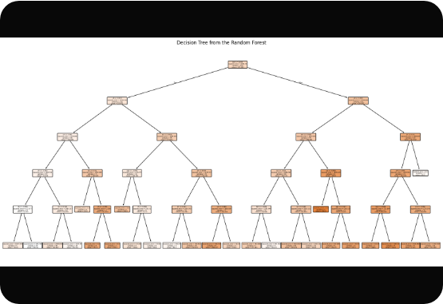
Model Architecture
Random Forest Classifier
Chosen for its ensemble learning capabilities, the Random Forest model provides:
•
High resistance to over-fitting through bagging.
•
Ability to handle high-dimensional text data efficiently.
•
Feature importance tracking for transparency.

Slide 8
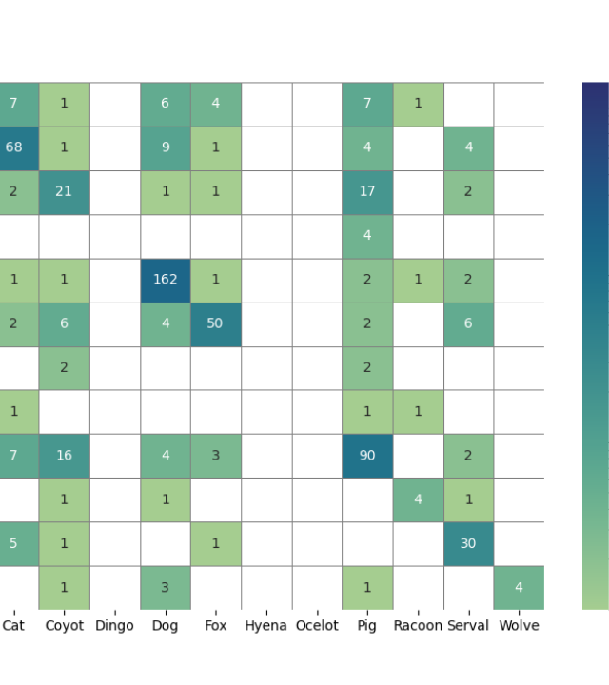
Confusion Matrix
Performance Analysis
The model shows exceptional performance in Sport (67/68 correct) and Business (63/66 correct).
A slight overlap is noted between Tech and Business due to the shared terminology in corporate technology news.

Slide 9
Metric Evaluation
Category | Correct | Precision | Recall
Sport | 67 | 0.98 | 0.98
Business | 63 | 0.95 | 0.94
Entertainment | 51 | 0.93 | 0.93
Politics | 48 | 0.91 | 0.90

Slide 10
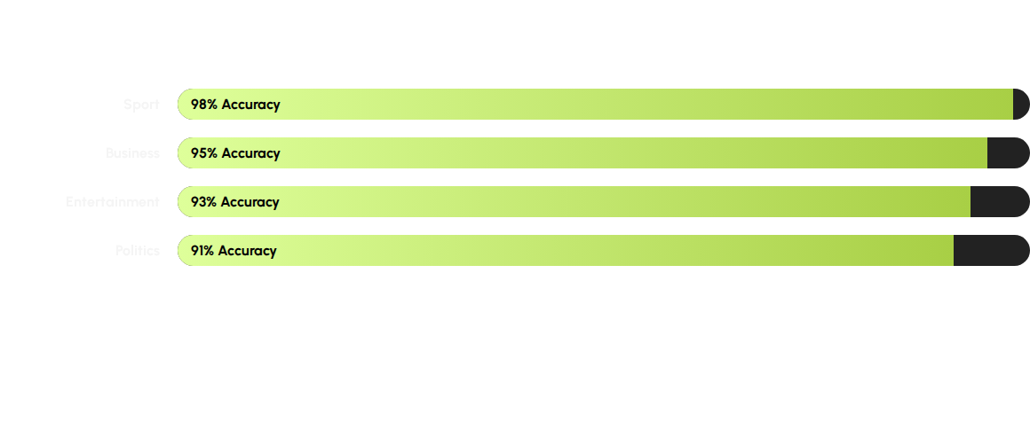
Category Accuracy
Final Average Test Accuracy: ~94.5%

Slide 11
Deployment Roadmap
Training
Serialization
FastAPI
Scalability
Optimize Random Forest parameters in Colab.
Export model and TF-IDF vectorizer using Joblib.
Develop REST API for real-time inference.
Deploy via Docker for microservices architecture.

Slide 12
Questions?
NewsBot Intelligent System Project
github: https://github.com/khuliso-ML/ITAI2373-NewsBot-Midterm developer@intelligent-systems.com

Slide 13



Image Sources
https://photos.peopleimages.com/picture/202303/2811275-head-ai-robot-and-futuristic-3d-in-studio-isolated-on-a-background-or-backdrop.-profile-cyber-and-bot-droid-or-machine-digital-cyborg-or-render-robotic-face-or-artificial-intelligence-generated-fit_400_400.jpg
Source: peopleimages.com
https://mljar.com/blog/visualize-sklearn-tree/sklearn_plot_regression.png
Source: mljar.com
https://towardsdatascience.com/wp-content/uploads/2024/09/1yq_JxFCjlAyVYIdiIHVtnA.png
Source: towardsdatascience.com

